Slide 1
Modeling Data
Week 2

Slide 2
Time For The Fun Stuff
Spent Last Week Cleaning Our Data
Now Time To Model It
What Models Do We Use? Classification vs. Regression
Is The Model Good Enough? Performance
What Is The Model Telling Me? Coefficients and R2

Slide 3
What Model Technique do I Use?
What Are You Trying To Solve For?
Risk of A Bank Crashing?
How Many Episodes of Netflix Will You Watch Today
Amount of Time It Will Take For A Deliver To Get To You
Generalized Linear Modeling (GLM)
Linear
Logistic

Slide 4
Linear Regression
Great For Answering Question With A Continuous Output
(-∞,∞)
What Other Questions Could We Answer With This Type of Modeling?
Most Popular For of Predictive Modeling
Marketing effectiveness – funding a project, consumer behavior
Medical diagnosis – does smoking causes lung cancer? Obesity and heart disease?
Forecasting Sales
Coronavirus: age vs. death rate, age vs. cases, race vs. cases
Traffic Accidents: population density vs violations
Starter Code
Model<- lm(formula=y~x1+x2, data=df) then summary (model)
Lm = Linear Model
Y = Dependent Variable,while x1, x2 = Independent Variables
data=df is the data frame

Slide 5
Linear Regression
What is a linear relationship? Simple vs. Multiple Linear Regression?
What is a closed form solution – why do we need to address multicollinearity?
Importance of Coefficient of Determination = R2
Assumes the data is normally distributed, features are not collinear
Residual Normal Q-Q plot should be a good fit
What is a p-value? Importance of p-value?

Slide 6
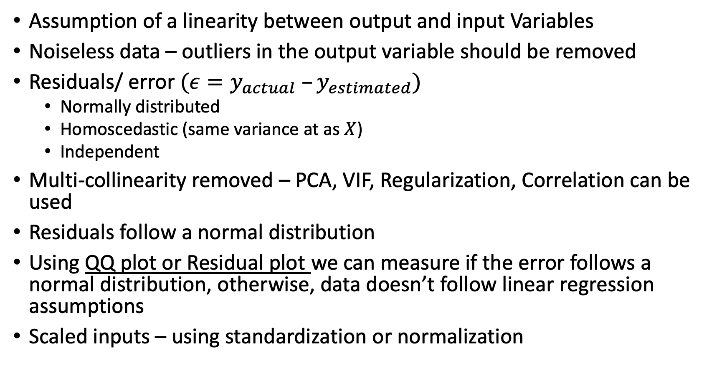
Linear Regression Assumptions
Assumption of a linearity between output and input Variables
Noiseless data – outliers in the output variable should be removed
Residuals/ error $({ε=y}_{actual} –y_{estimated})$
Normally distributed
Homoscedastic (same variance at as $X$)
Independent
Multi-collinearity removed – PCA, VIF, Regularization, Correlation can be used
Residuals follow a normal distribution
Using QQ plot or Residual plot we can measure if the error follows a normal distribution, otherwise, data doesn’t follow linear regression assumptions
Scaled inputs – using standardization or normalization

Slide 7
Pre-processing before Regression
If we don’t standardize, cost function will be more influenced by features with larger values
Outlier detection
Univariate using box plots
Multivariate using Mahalanobis distance
Multivariate Gaussian Distribution

Slide 8
P Value
Determines Which Variables Are Important
Nice To Know Info From Coefficients…
If Variable Is Not Significant, That Data Is Not As Relevant
Lower The Value, The More Significant In Helping Predict
Typically <.05 Is The Threshold
Not A Science, May Be Able To Consider Values That Are Within Range

Slide 9
Coefficients
Using Coefficients To Understand Results
Helps Us Understand The Relationship Between Independent Variables & Dependent
Positive Number
The More That The Value of This Variable Increases, The Dependent Value Will As Well
Positive Correlation
The Higher The Units Sold, The Higher The Revenue
Negative Number
The More That The Value of This Variable Decreases, The Dependent Value Will Fall
The Longer The House Is On The Market, The Prices of It Will Decrease
Ultimately Shows Us The Impact of Variable On Output

Slide 10
Selection Optimization
AIC (or BIC) – lower the better; penalizes if model is too complex (too many variables), rewards if better model fit
Three Main Methods
Forward - which starts with no predictors in the model, iteratively adds the most contributive predictors, and stops when the improvement is no longer statistically significant
Backwards - which starts with all predictors in the model (full model), iteratively removes the least contributive predictors, and stops when you have a model where all predictors are statistically significant.
Stepwise / (or sequential replacement) - which is a combination of forward and backward selections. You start with no predictors, then sequentially add the most contributive predictors (like forward selection). After adding each new variable, remove any variables that no longer provide an improvement in the model fit (like backward selection).
Essential For Variable Reduction

Slide 11
Forward Selection
You Also May See This Called Forward Stepwise
Optimizes Your Model By Starting With 0 Variables
Looks For The Strongest Variable (Lowest P Value)
Keeps Adding Variables Until Optimization Score Falls Off
Multiple Linear: R2
Multiple Logistic: Logloss, AUC or Gini Coefficient
Example
Model Has 30 Variables
Model Hits 12th Variable & R2 Drops
Process Stops At 12 Variables
StepModel<-step(model,direction=“forward”)

Slide 12
Backward Selection
You Also May See This Called Backward Stepwise
Optimizes Your Model By Starting With All Variables
Looks For The Weakest Variable (Highest P Value)
Keeps Deducting Variables Until Optimization Score Falls Off
Multiple Linear: R2
Multiple Logistic: Logloss, AUC, Gini, AIC
Example: Model With 30 Variables
Has Dropped 7 Variables and Score Drops Off
Model Has 23 Variables
StepModel<-step(model,direction=“backward”)

Slide 13
Logistic Regression
Great For Answering Question With A Binary Output
(0,1)
What Other Questions Could We Answer With This Type of Modeling?
Classification problem
Can we solve Non-linear relationships using LR?
Popular But Often Overlooked For Predictive Modeling
Chance of A Storm?
Will I Make A Profit?
Spam/ No Spam?
Genetic Disease?
Starter Code
Model<-glm(formula=y~x1+x2,family=binomial”logit”, data=df)
glm = Gernalized Linear Model
Y = Dependent Variable,while x1, x2 = Independent Variables
data=df is the data frame
Log-odds as a coefficient

Slide 14
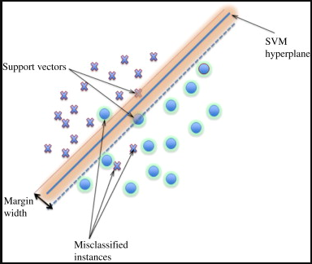
Support Vector Machines - SVM
First define soft margin classifiers – allows for misclassifications
Uses cross validation
Points in and within the soft margin is called support vectors
Penalty for misclassifications can be controlled using the parameter C
Uses Kernel functions to convert linear problems in to non-linear domains
Polynomial
Radial Basis Function
Uses Kernel trick which is memory efficient

Slide 15
SVM – Pros and Cons
Pros
Great for classification problems – generates a high-dimensional hyper-plane for discrimination between classes
Works with non-linear relationships
Uses subset of training points (support vectors) for classification, therefore it’s less memory consuming
Cons
Doesn’t work great with larger datasets
Doesn’t work well with noisy data – i.e when classes are overlapping with each other
Don’t get a probability value as an output
Reading:
https://jakevdp.github.io/PythonDataScienceHandbook/05.07-support-vector-machines.html
https://towardsdatascience.com/a-guide-to-svm-parameter-tuning-8bfe6b8a452c

Slide 16
Regularization
What is overfitting? What is Bias-Variance problem?
Ridge regression? Pushes features towards zero but not zero.
Lasso regression? Pushes features towards zero, can be zero; one features goes up, other goes down.
L0 regression? Pushes features towards zero, can be zero; one features goes up exponentially, other goes down exponentially.

Slide 17
Pre Model Steps
Make Sure Your Data is CLEAN!
Run Correlation & Heat Matrices
See Which Data Points Are Related To Each Other
Could Potentially Find VIF – Variance Inflation Factor is used to find multicollinearity between >2 variables
Multiple Fields Are Overly Correlated Eg: Sales, Advertising & Margin
VIF explains the linear relationship (R2) of each dep. variable against other dep. variable/s
VIF between 5-10 should be addressed, >10 should be removed
Training & Test Data Sets
Training = Data Set To Build Our Model Off Of
Validation set = used to find the best hyper-parameters within a given model
Test = Simulation of Live Data (New Data)
How Do I Get Those
Training = 60% of total Dataset for classical ML and 90% for Deep Neural Networks with large amount of data
Validation = 20% of total Dataset for classical ML and 5% for Deep Neural Networks with large amount of data
Test = 20% of total Dataset for classical ML and 5% for Deep Neural Networks with large amount of data
Need to Test Models For Randomization!

Slide 18
Understanding Output
Key Outputs
Coefficients
P Value
R2
MSE/ RMSE/ MAPE (mean absolute % error)
ROC Curve
QQ Plot
F1 statistic

Slide 19
Field Of Measure (Confusion Matrix)
No Accepted Measure of Success
MSE
AIC
BIC
Confusion Matrix Allows Us To…
Accuracy Of Model In Ways Of…
True Positives
False Positives
Importance of Those Vary By Business
Install.packages(“caret”)
Library(caret)
Fitted.results <- predict.glm(Model,newdata=data,type=“response”)
Fitted.results<-ifelse(Fitted.results>.5,1,0)
Classify <- mean(Fitted.results!=df$predict_var)
print(paste(‘Accuracy’,1-Classify)) -> Will tell us Accuracy of Model

Slide 20
Class Project
Pick A Problem From “Heart.csv” Data Set
Linear
Logistic
Use p-values to describe a statistically significant in the results (use Netflix data)
Define What You Want To Predict
Run The Code In R For Variables of Your Choice (Use At Least 7 Variables)
What Are The Outputs??
Coefficient Interpretations
Important Variables
Is The Model Any Good?

Slide 21
References
https://towardsai.net/p/data-science/how-when-and-why-should-you-normalize-standardize-rescale-your-data-3f083def38ff#:~:text=Normalization%3A,in%20the%20ranges%20of%20values.&text=So%20we%20normalize%20the%20data,variables%20to%20the%20same%20range.
https://blog.minitab.com/blog/adventures-in-statistics-2/regression-analysis-how-do-i-interpret-r-squared-and-assess-the-goodness-of-fit
https://blog.minitab.com/blog/adventures-in-statistics-2/why-you-need-to-check-your-residual-plots-for-regression-analysis

